Slide 1
Accounting Principles, 7th Edition
Weygandt • Kieso • Kimmel
Chapter 8
Internal Control and Cash
Prepared by Naomi Karolinski
Monroe Community College
and
Marianne Bradford
Bryant College
John Wiley & Sons, Inc. © 2005

Slide 2
CHAPTER 8 INTERNAL CONTROL AND CASH
After studying this chapter, you should be able to:
1 Define internal control.
2 Identify the principles of internal control.
3 Explain the applications of internal control principles to cash receipts.
4 Explain the applications of internal control principles to cash disbursements.
5 Describe the operation of a petty cash fund.
6 Indicate the control features of a bank account.
7 Prepare a bank reconciliation.
8 Explain the reporting of cash.

Slide 3
INTERNAL CONTROL
STUDY OBJECTIVE 1
Internal Control
Safeguards an organization’s assets
Enhances the accuracy and reliability of accounting records

Slide 4
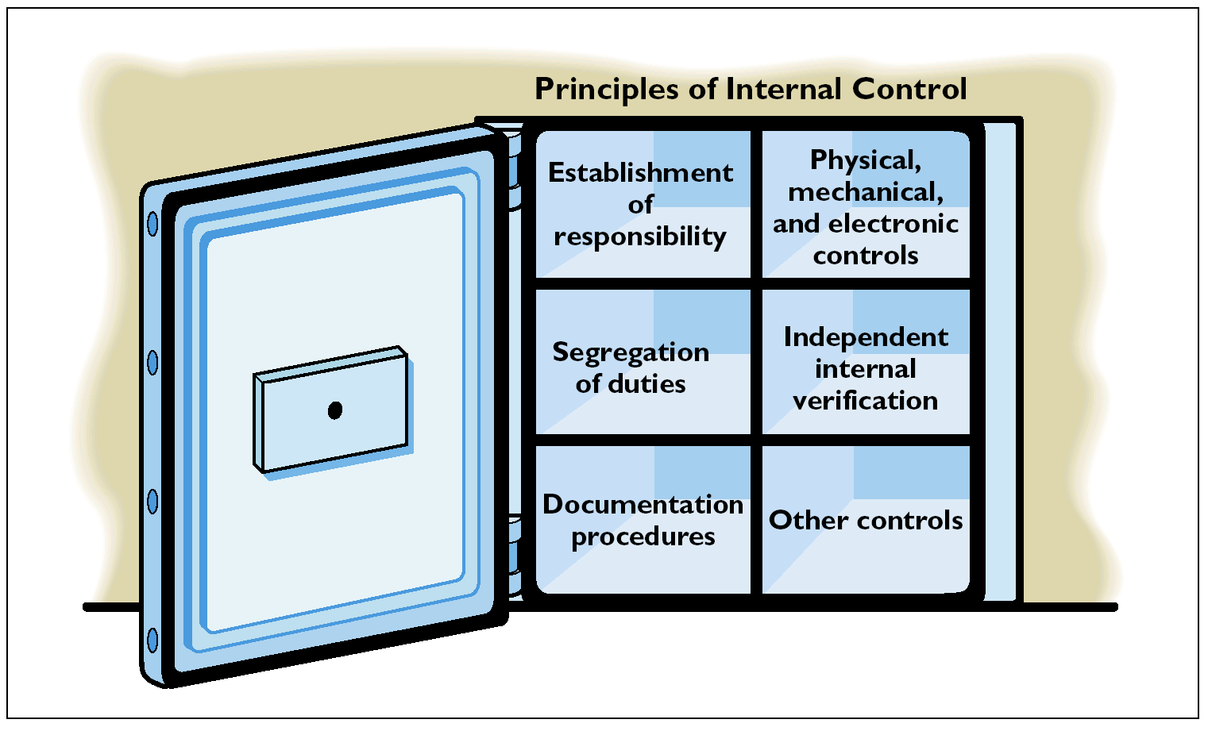
PRINCIPLES OF INTERNAL CONTROL
STUDY OBJECTIVE 2

Slide 5
PRINCIPLES OF INTERNAL CONTROL
Establishment of responsibility:
  most effective when only one person is responsible for a given task
Segregation of duties:
  the work of one employee should provide a reliable basis for evaluating the work of another employee
Documentation procedures:
  documents provide evidence that transactions and events have occurred

Slide 6
PRINCIPLES OF INTERNAL CONTROL
Physical, mechanical, and electronic controls:
safeguarding of assets and enhancing accuracy and
reliability of the accounting records.
Independent internal verification:
  the review, comparison, and reconciliation of information from two sources.
Other controls:
  bonding of employees who handle cash, rotating employee’s duties, and requiring employees to take vacations.

Slide 7
PHYSICAL, MECHANICAL, AND ELECTRONIC CONTROLS
Locked warehouses and storage cabinets for inventories and records
Safes, vaults, and safety deposit boxes for cash and business papers
Time clocks for recording time worked
Computer facilities with pass key access
Alarms to prevent break-ins
Television monitors and garment sensors to deter theft

Slide 8
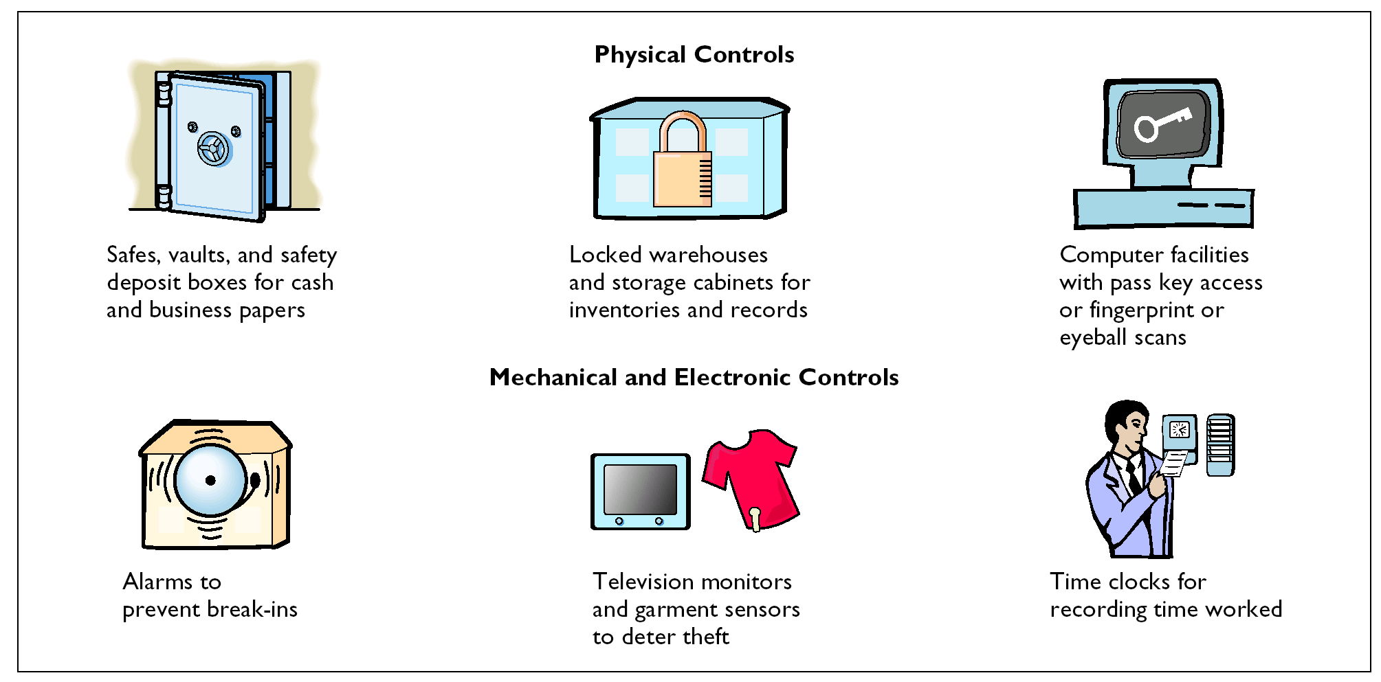
PHYSICAL, MECHANICAL, AND ELECTRONIC CONTROLS

Slide 9
INDEPENDENT INTERNAL VERIFICATION
Maximum benefit
Independent internal verification:
1 Made on periodic or surprise basis
2 Should be done by someone who is independent of the employee responsible for the information
3 Report discrepancies and exceptions to a management level that can take appropriate corrective action

Slide 10
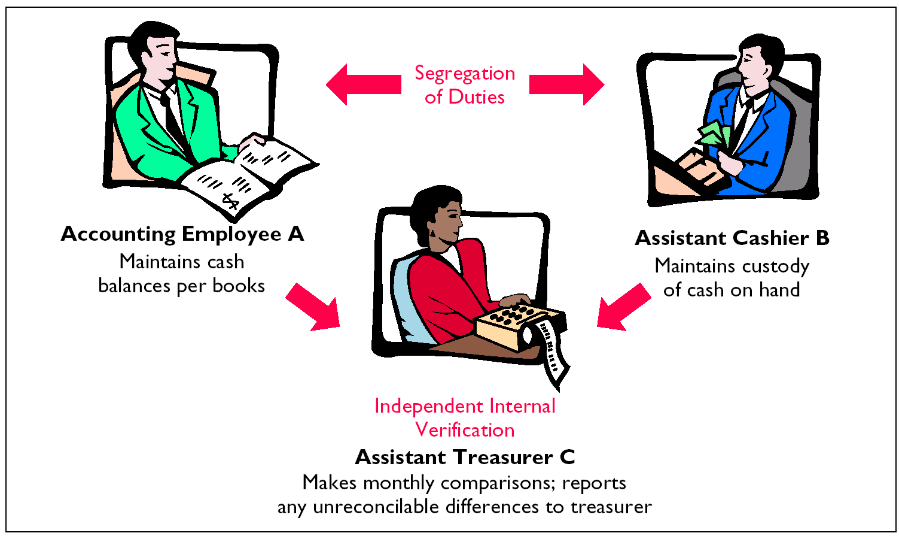
COMPARISON OF SEGREGATION OF DUTIES PRINCIPLE WITH INDEPENDENT INTERNAL VERIFICATION PRINCIPLE

Slide 11

LIMITATIONS OF INTERNAL CONTROL
Costs of establishing control procedures should not exceed their expected benefits
The human element is an important factor in every system of internal control.
  A good system can become ineffective through employee fatigue, carelessness, or indifference.
Collusion may result.
  Two or more individuals work together to get around prescribed controls and may significantly impair the effectiveness of a system.

Slide 12
CASH
Cash
  Coins, currency, checks, money orders, and money on hand or on deposit at a bank or similar depository
Internal control over cash is imperative
  Safeguards cash and assure the accuracy
  of the accounting records for cash

Slide 13

CONTROL OVER CASH RECEIPTS
STUDY OBJECTIVE 3
Only designated personnel should be authorized to handle or have access to cash receipts.
Different individuals should:
1 receive cash
2 record cash receipt transactions
3 have custody of cash

Slide 14
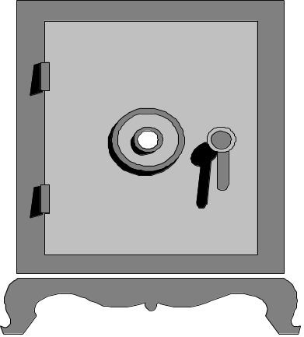
CONTROL OVER CASH RECEIPTS
Documents should include:
1 Remittance advices
2 Cash register tapes
3 Deposit slips
Cash should be stored in safes and bank vaults
Access to storage areas should be limited to authorized personnel
Cash registers should be used in executing over-the-counter receipts

Slide 15
Internal control is used in a business to enhance the accuracy and reliability of its accounting records and to:
Review
safeguard its assets.
prevent fraud.
produce correct financial statements.
deter employee dishonesty.

Slide 16
Internal control is used in a business to enhance the accuracy and reliability of its accounting records and to:
Review
safeguard its assets.
prevent fraud.
produce correct financial statements.
deter employee dishonesty.

Slide 17
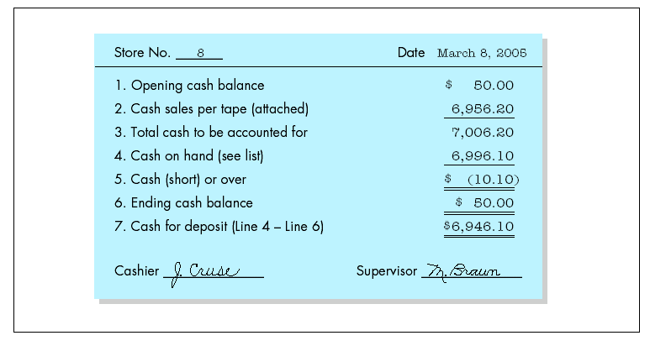
CONTROL OVER CASH RECEIPTS
Daily cash counts and daily comparisons of total receipts.
All personnel who handle cash receipts should be bonded and required to take vacations.
Control of over-the-counter receipts is centered on cash registers that are visible to customers.

Slide 18
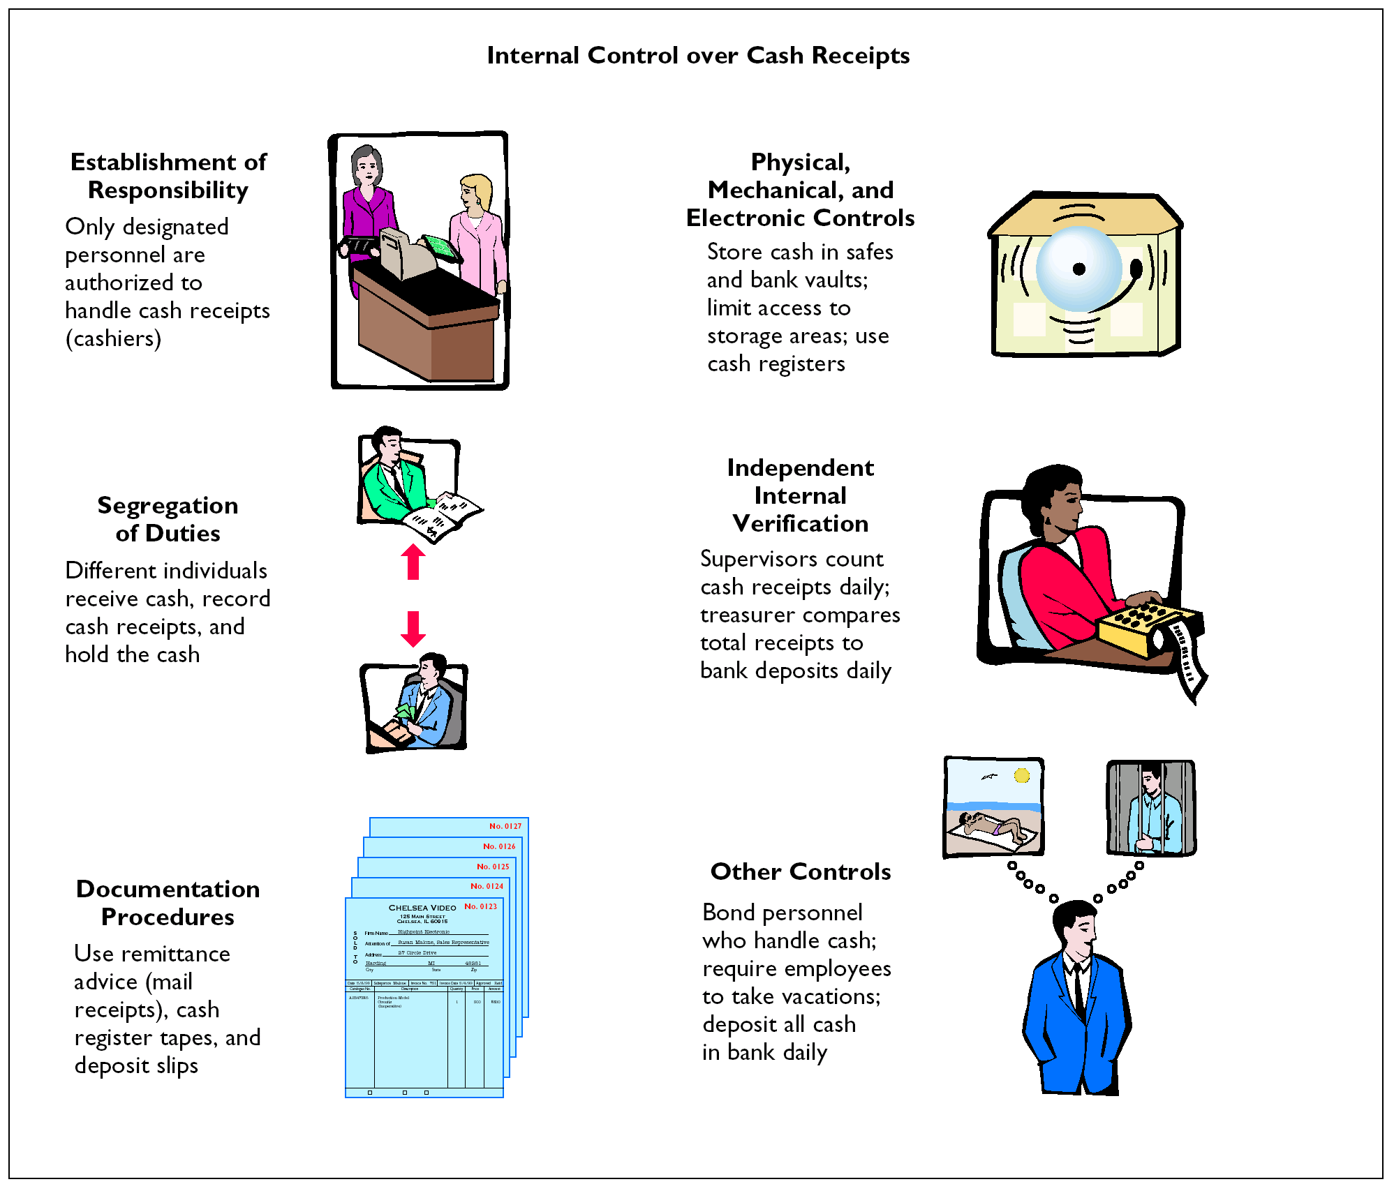

Slide 19
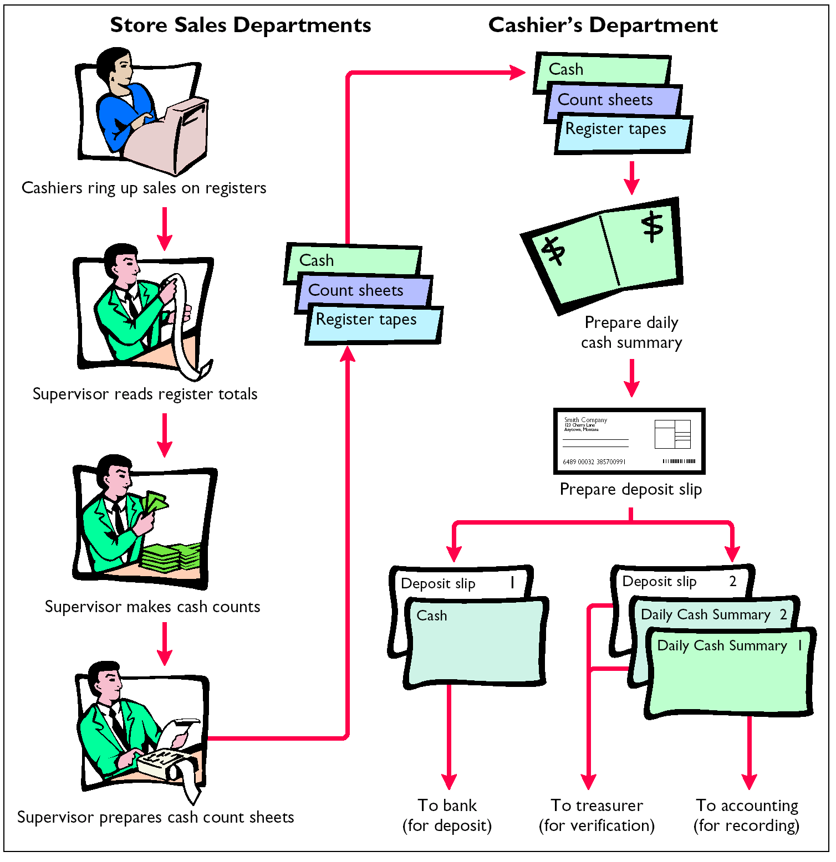

Slide 20
CONTROL OVER CASH DISBURSEMENTS
STUDY OBJECTIVE 4
Payments are made by check rather than by cash, except for petty cash transactions.
Only specified individuals should be authorized to sign checks.
Different departments or individuals should be assigned the duties of approving an item for payment and paying it.

Slide 21
CONTROL OVER CASH DISBURSEMENTS
Prenumbered checks should be used and each check should be supported by an approved invoice or other document.
Blank checks should be stored in a safe.
1 Access should be restricted to authorized
personnel.
2 A check writer machine should be used to imprint the amount on the check in indelible ink.

Slide 22

CONTROL OVER CASH DISBURSEMENTS
Each check should be compared with the approved invoice before it is issued.
Following payment, the approved invoice should be stamped “PAID”.
Paid

Slide 23
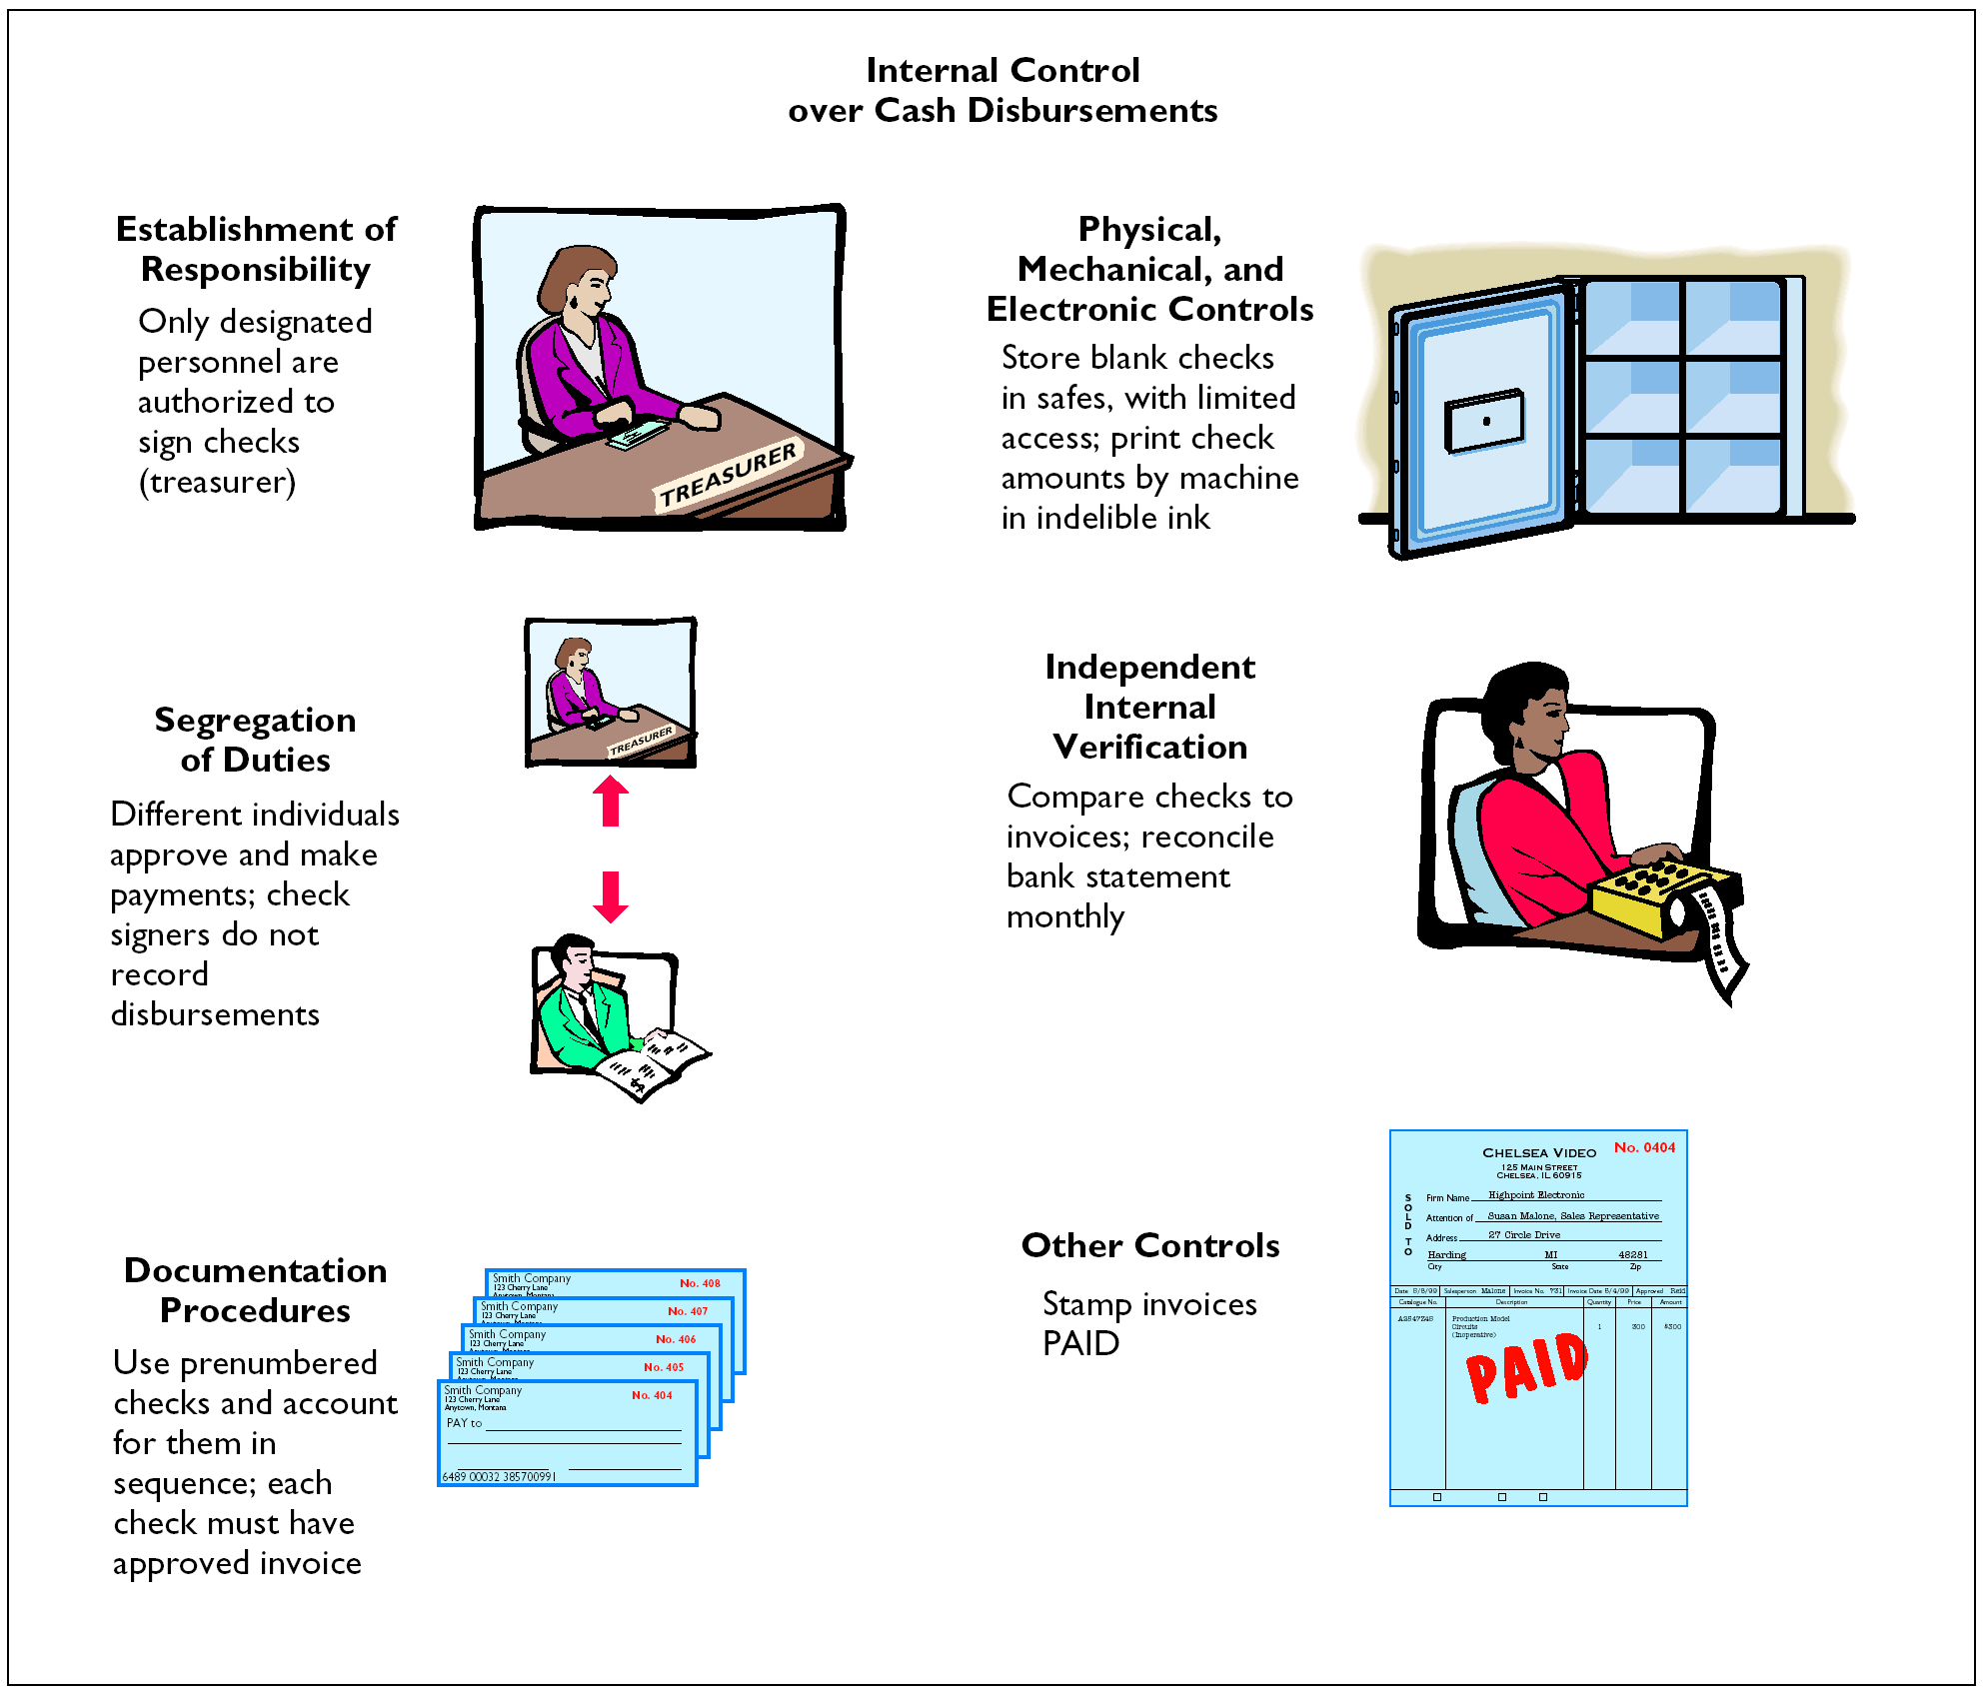

Slide 24
VOUCHER SYSTEM
The voucher system
  Is often used to enhance the internal control over cash disbursements.
  Is an extensive network of approvals by authorized individuals acting independently to ensure that all disbursements by check are proper.
A voucher is an authorization form prepared for each expenditure.
Vouchers are recorded in a journal called the voucher register.

Slide 25

ELECTRONIC FUNDS TRANSFER SYSTEM
Checks processing is expensive
  New methods are being developed to transfer funds among parties without the use of paper
Electronic Funds Transfer (EFT) System A disbursement system that uses wire, telephone, telegraph, or computer to transfer cash from one location to another

Slide 26
PETTY CASH FUND
STUDY OBJECTIVE 5
A petty cash fund is used to pay relatively small amounts
Operation of the fund, often called an imprest system, involves:
1 Establishing the fund
2 Making payments from the fund
3 Replenishing the fund
Accounting entries are required when:
1 The fund is established
2 The fund is replenished
3 The amount of the fund is changed

Slide 27
ESTABLISHING THE FUND
Two essential steps in establishing a petty
cash fund are:
1 appointing a petty cash custodian who
will be responsible for the fund and
2 determining the size of the fund.
Ordinarily, the amount is expected to cover
anticipated disbursements for a 3 to 4 week
period.

Slide 28
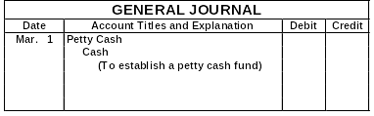
ESTABLISHING THE FUND
100
100
When the fund is established, a check payable to the petty cash custodian is issued for the stipulated amount.

Slide 29
REPLENISHING THE FUND
When the money in the petty cash fund reaches a minimum level, the fund is replenished.
The request for reimbursement is initiated by the
petty cash custodian.
The petty cash custodian prepares a schedule of
the payments that have been made and sends the
schedule, with supporting documentation, to the
treasurer’s office.

Slide 30
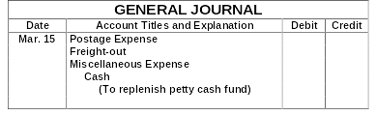
REPLENISHING THE FUND
44
38
5
87
On March 15 the petty cash custodian requests a check for $87. The fund contains $13 cash and petty cash receipts for postage, $44, freight-out, $38, and miscellaneous expenses, $5.

Slide 31
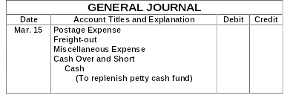
REPLENISHING THE FUND
44
38
5
1
88
On March 15 the petty cash custodian requests a check for $88. The fund contains $12 cash and petty cash receipts for postage, $44, freight-out, $38, and miscellaneous expenses, $5.

Slide 32

USE OF A BANK
STUDY OBJECTIVE 6
The use of a bank minimizes the amount of currency that must be kept on hand and contributes significantly to good internal control over cash.
A company can safeguard its cash by using a bank as a depository and as a clearing house for checks received and checks written.

Slide 33
WRITING CHECKS
A check is a written order signed by the depositor directing the bank to pay a specified sum of money to a designated recipient.
Three parties to a check are:
1 Maker (drawer) issues the check
2 Bank (payer) on which check is drawn
3 Payee to whom check is payable

Slide 34
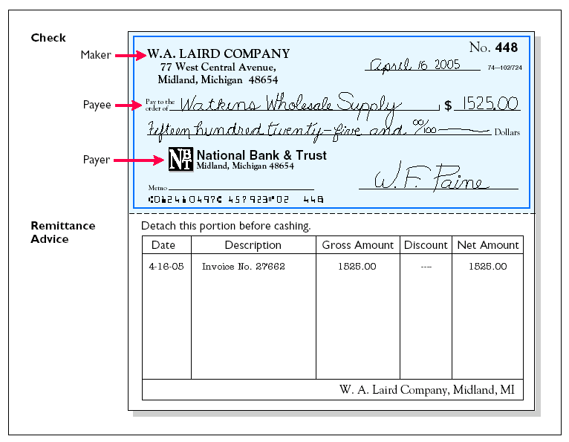
WRITING CHECKS

Slide 35
BANK STATEMENTS
A bank statement shows:
1 Checks paid and other debits charged against the account
2 Deposits and other credits made to the account
3 Account balance after each day’s transactions

Slide 36
MEMORANDA
Bank debit memoranda
  Indicate charges against the
  depositor’s account.
Example: ATM service charges
Bank credit memoranda
  Indicate amounts that will increase
  the depositor’s account.
Example: interest income on account
balance

Slide 37
RECONCILING THE BANK ACCOUNT
STUDY OBJECTIVE 7
Reconciliation
  Necessary as the balance per bank and balance per books are seldom in agreement due to time lags and errors.
A bank reconciliation
  Should be prepared by an employee
  who has no other responsibilities
  pertaining to cash.

Slide 38
RECONCILING THE BANK ACCOUNT
  Steps in preparing a bank reconciliation:
  1 Determine deposits in transit
  2 Determine outstanding checks
  3 Note any errors discovered
  4 Trace bank memoranda to the records
Each reconciling item used in determining the adjusted cash balance per books should be recorded by the depositor.

Slide 39
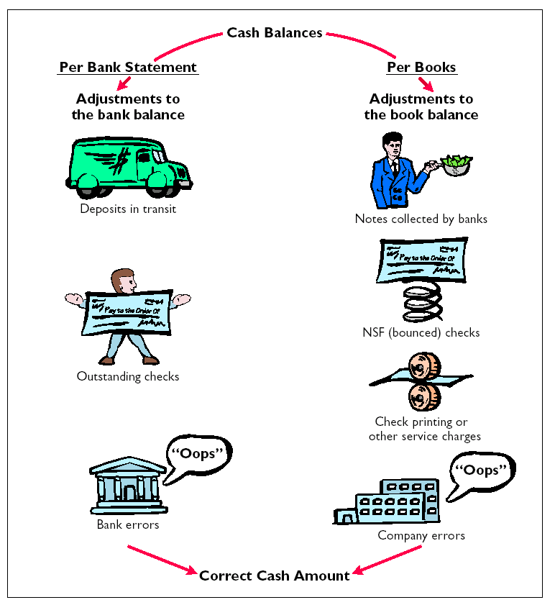
BANK RECONCILIATION

Slide 40
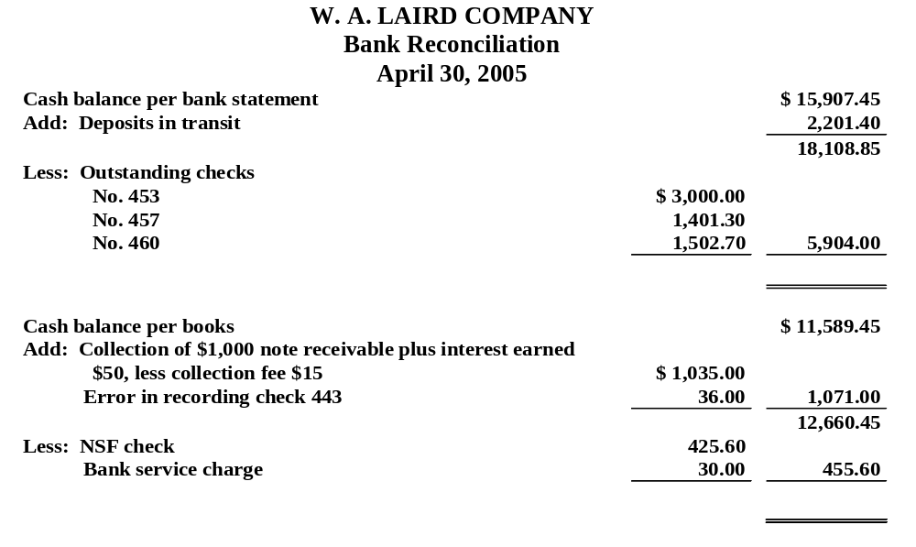
BANK RECONCILIATION
The bank statement for the Laird Company shows a balance per bank of $15,907.45 on April 30, 2005.
Adjusted cash balance per bank $ 12,204.85
Adjusted cash balance per books $ 12,204.85
On this date the balance of cash per books is $11,589.45.
Notes:
Fix-the 12,202 under adjusted cash balance per books.

Slide 41
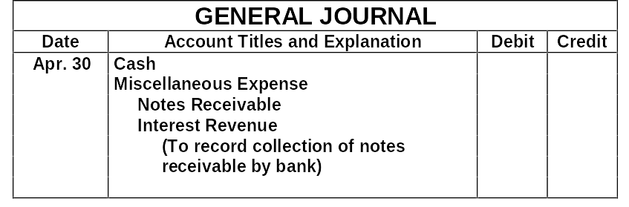
ENTRIES FROM BANK RECONCILIATION
1035
15
1000
50
Collection of Note Receivable: This entry involves four accounts. Interest of $50 has not been accrued and the collection fee is charged to Miscellaneous Expense.

Slide 42
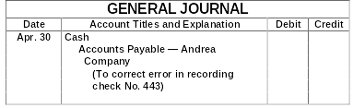
ENTRIES FROM BANK RECONCILIATION
36
36
Book Error: An examination of the cash disbursements journal shows that check No. 443 was a payment on account to Andrea Company, a supplier. The check, with a correct amount of $1,226.00, was recorded at $1,262.00.

Slide 43

ENTRIES FROM BANK RECONCILIATION
425.60
425.60
NSF Check: An NSF check becomes an accounts receivable to the depositor.

Slide 44
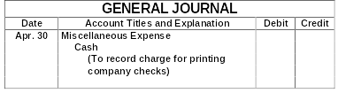
ENTRIES FROM BANK RECONCILIATION
30
30
Bank Service Charges: Check printing charges (DM) and other bank service charges (SC) are debited to Miscellaneous Expense because they are usually nominal in amount.

Slide 45
REPORTING CASH
STUDY OBJECTIVE 8
Cash reported on the Balance Sheet includes:
1 Cash on hand
2 Cash in banks
3 Petty cash
Cash is listed first in the balance sheet under the title cash and cash equivalents
because it is the most liquid asset.

Slide 46

CASH EQUIVALENTS
Cash equivalents
  Are highly liquid investments that can be converted into a specific amount of cash
  Typically have maturities of 3 months or less when purchased
Examples: Money market funds, bank certificates of deposit, and U.S. Treasury bills and notes

Slide 47
The statement that correctly describes the reporting of cash is:
Review
a. Cash cannot be combined with cash equivelants.
b. Restricted cash funds may be combined with
Cash.
c. Cash is listed first in the current assets.
d. Restricted cash funds cannot be reported as a
current asset.

Slide 48
The statement that correctly describes the reporting of cash is:
Review
Cash cannot be combined with cash equivelants.
Restricted cash funds may be combined with Cash.
Cash is listed first in the current assets.
Restricted cash funds cannot be reported as a current asset.

Slide 49

COPYRIGHT
Copyright © 2005 John Wiley & Sons, Inc. All rights reserved. Reproduction or translation of this work beyond that permitted in Section 117 of the 1976 United States Copyright Act without the express written consent of the copyright owner is unlawful. Request for further information should be addressed to the Permissions Department, John Wiley & Sons, Inc. The purchaser may make back-up copies for his/her own use only and not for distribution or resale. The Publisher assumes no responsibility for errors, omissions, or damages, caused by the use of these programs or from the use of the information contained herein.

